Slide 1

Passenger Reviews Sentiment Analysis

Slide 2
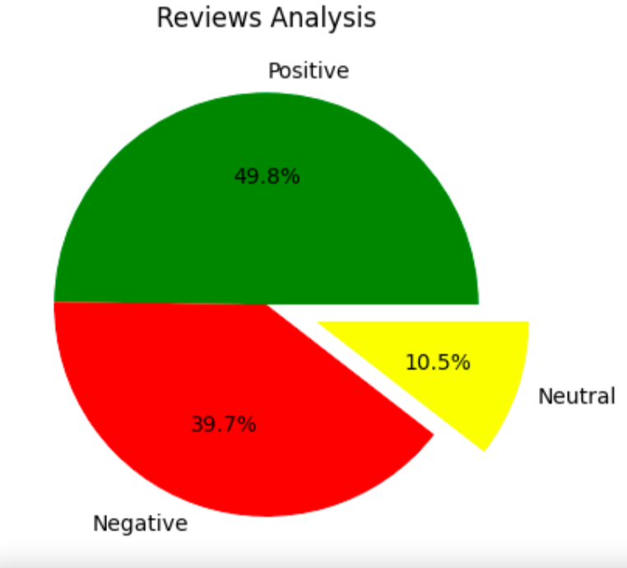
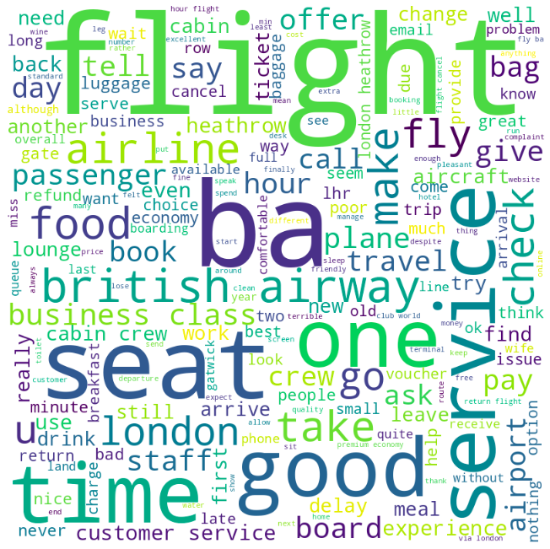
Insights from Passenger Reviews
Out of 1000 reviews sampled:
498 were positive
397 were negative
105 were neutral
Key Topics Words like ‘flight’, ‘service’, ‘seat’, ‘time’ and ‘good’ were the most frequently used, as visualised in the world cloud.

